Slide 1
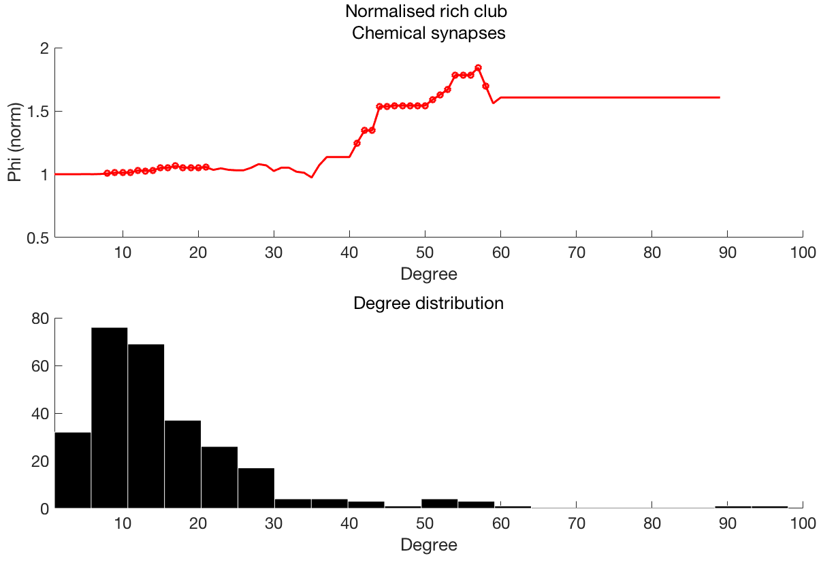
Normalised rich club coefficient
Degree>=k

Slide 2
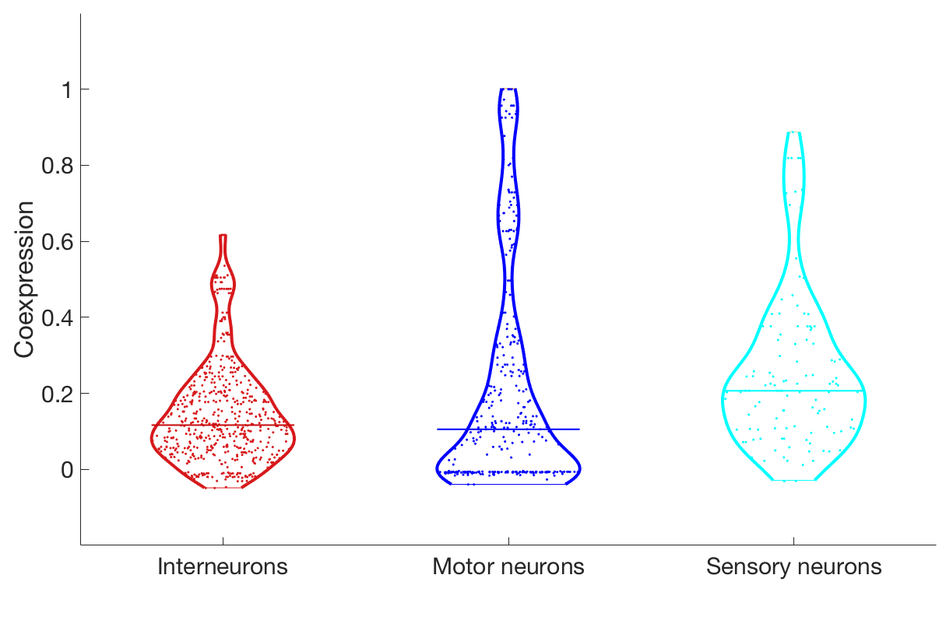
** p < 10⁻⁶
t=-5.34
** p < 10⁻⁴
t=-4.13
(φ)

Slide 3
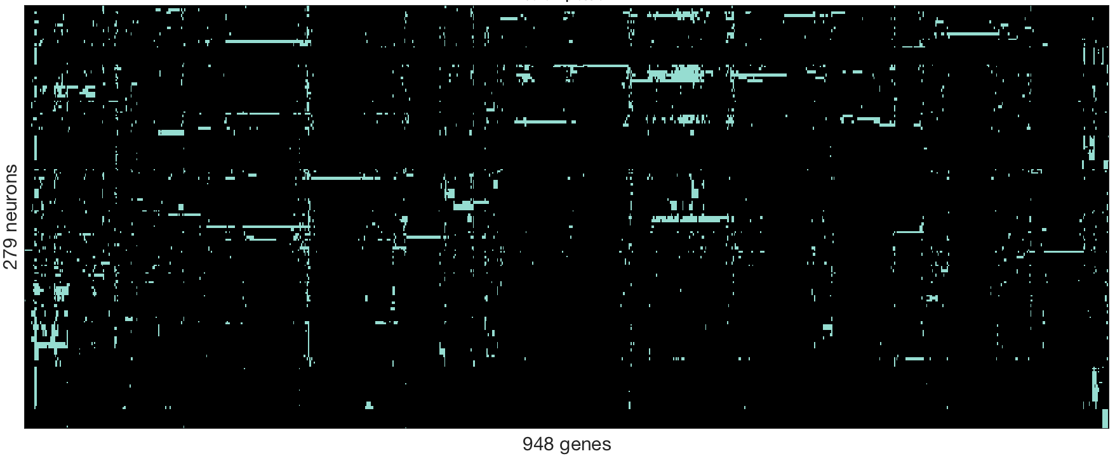
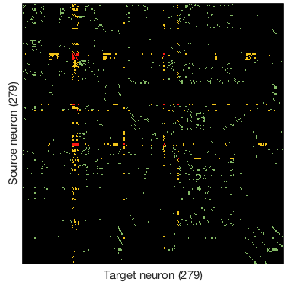
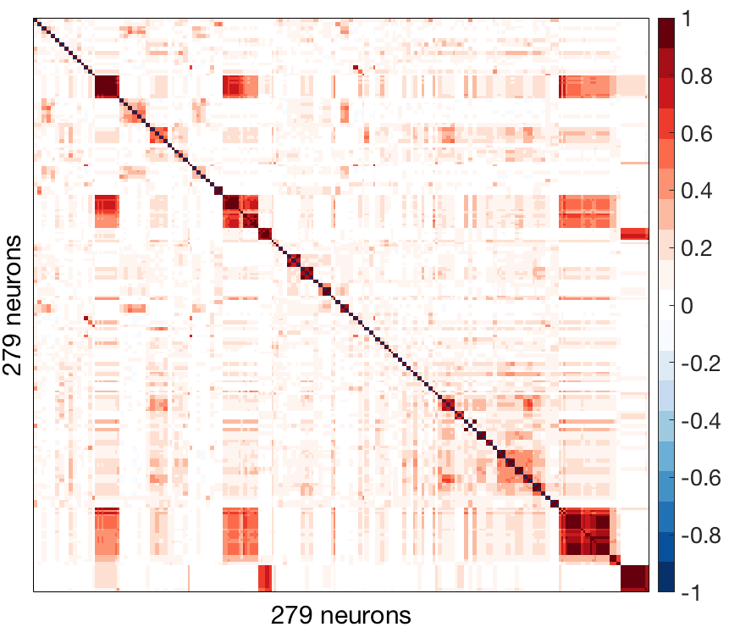
A: Gene expression
B: Connectivity
C: Gene coexpression

Slide 4
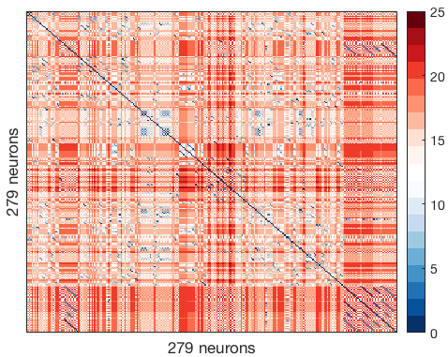
A: Gene expression
B: Connectivity
C: Gene coexpression
D: Lineage distance

Slide 5
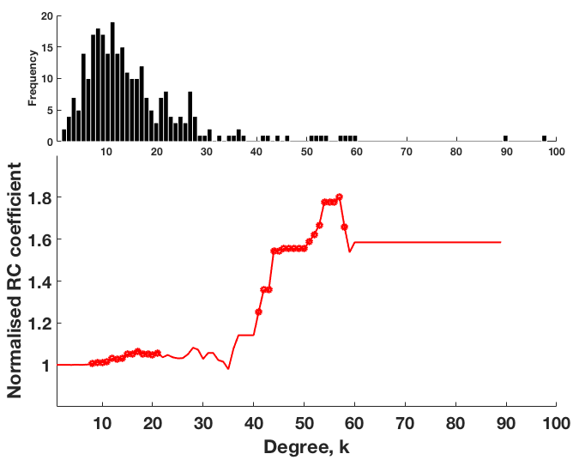

Slide 6
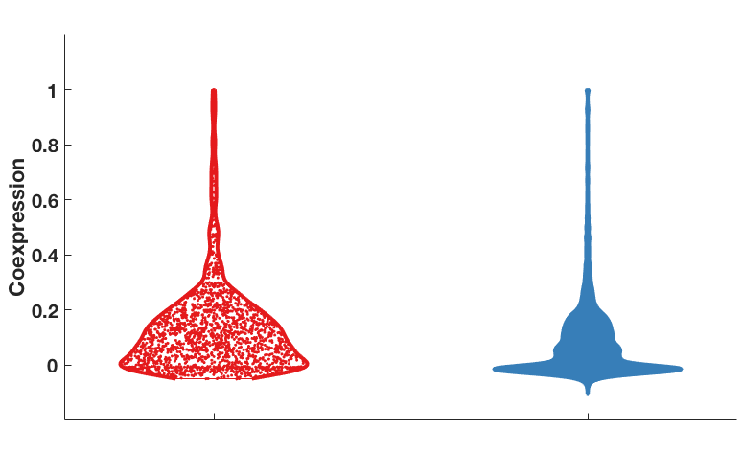
**p < 10⁻⁵⁰
(φ)
Connected
Unconnected

Slide 7
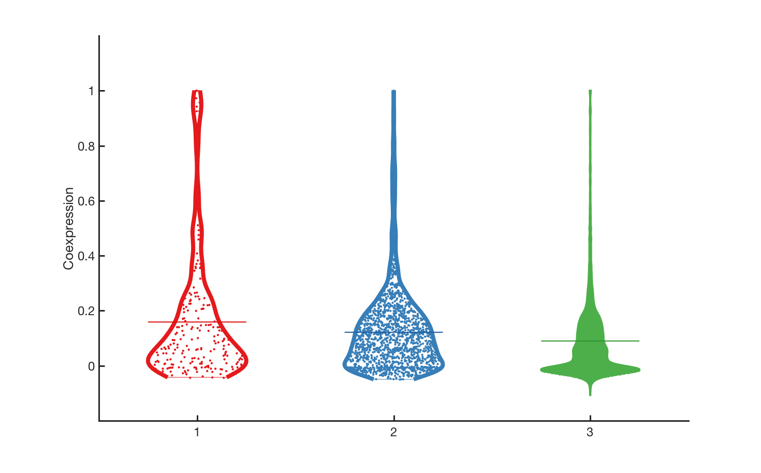
**p < 10⁻⁵
*p < 0.05
**p < 10⁻¹⁸
Coexpression (ϕ)
Reciprocal
connections
Unidirectional
connections
Unconnected

Slide 8
**p < 10⁻⁵
*p < 0.05
**p < 10⁻¹⁸
Coexpression (ϕ)
Reciprocal
connections
Unidirectional
connections
Unconnected

Slide 9
**p < 10⁻⁵
*p < 0.05
**p < 10⁻¹⁸
Coexpression (ϕ)
Reciprocal
connections
Unidirectional
connections
Unconnected

Slide 10
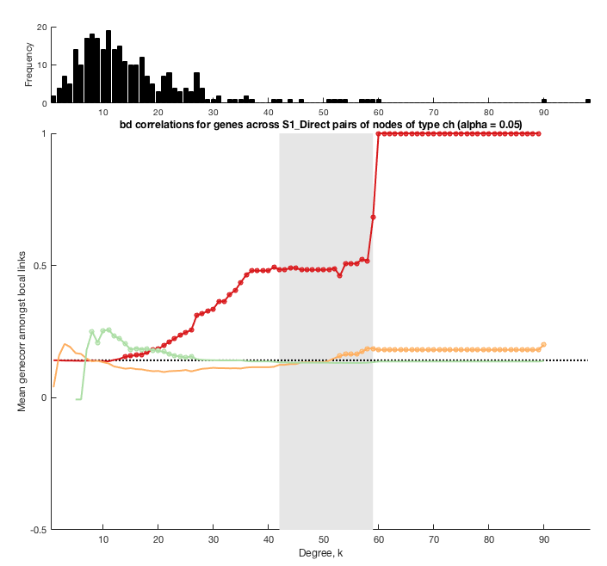

Slide 11
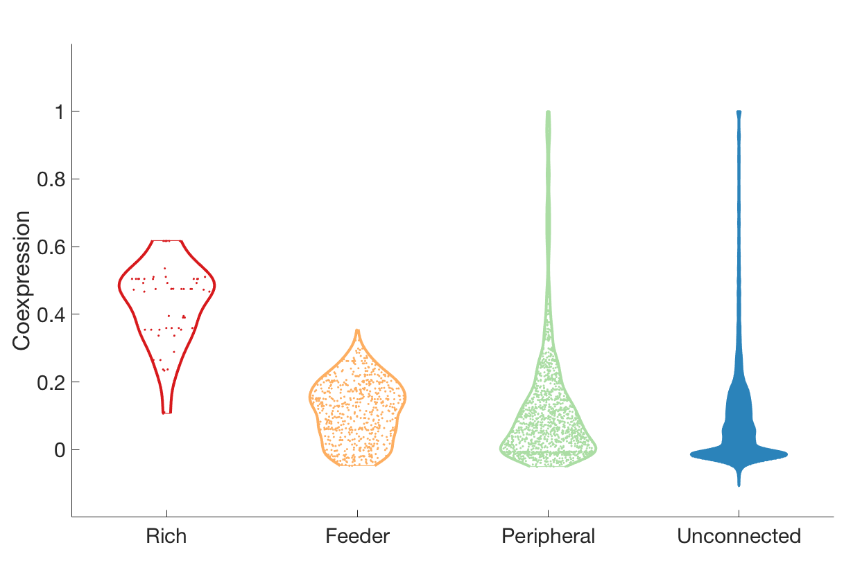
hub
non-hub
** p < 10⁻²⁸
** p < 10⁻¹⁰
(φ)
** p < 10⁻²⁸
** p < 10⁻⁷

Slide 12
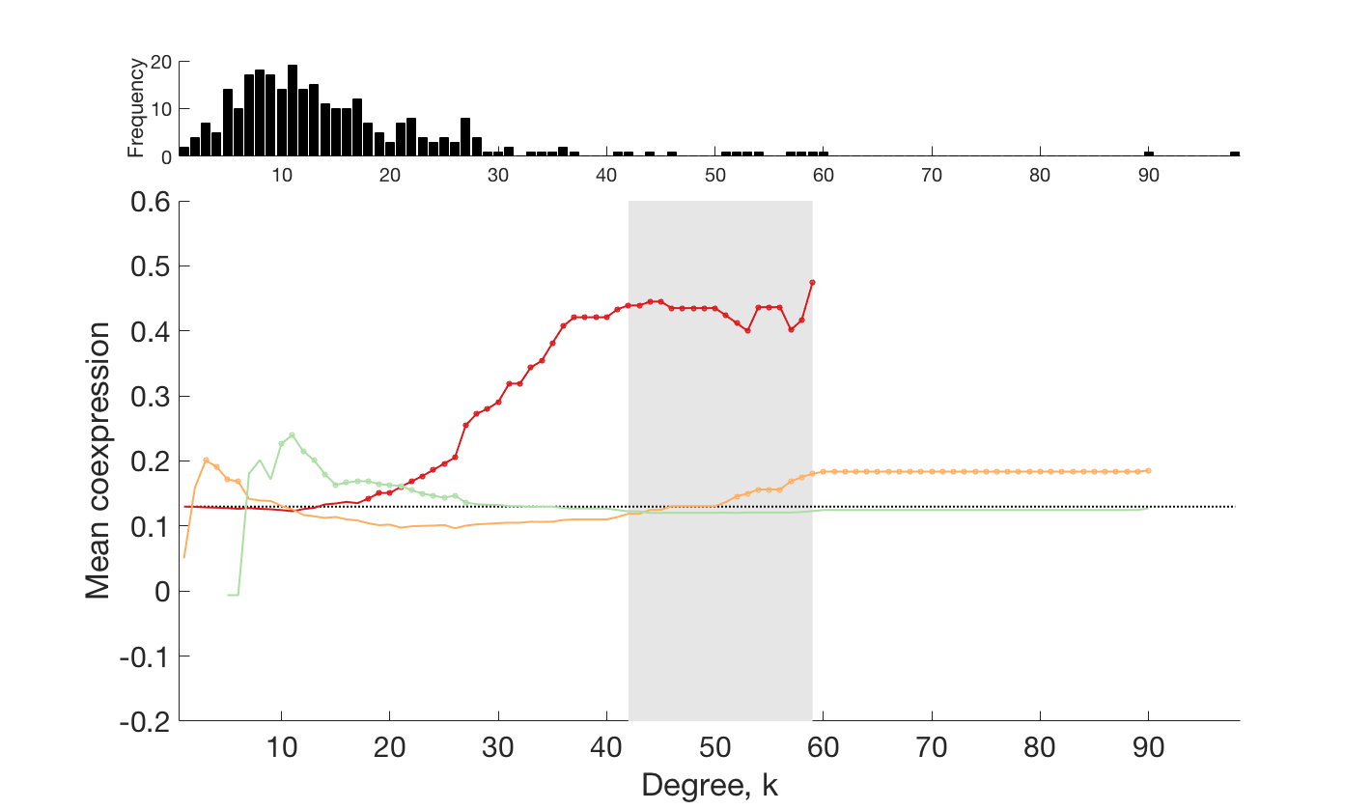
Rich
Feeder
Peripheral

Slide 13
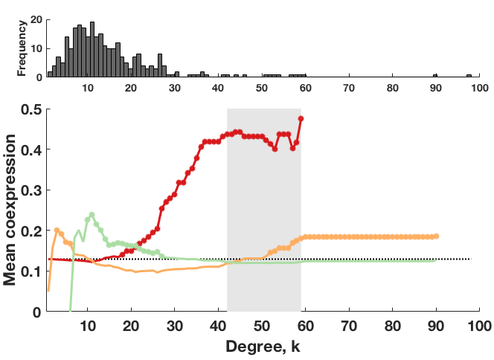
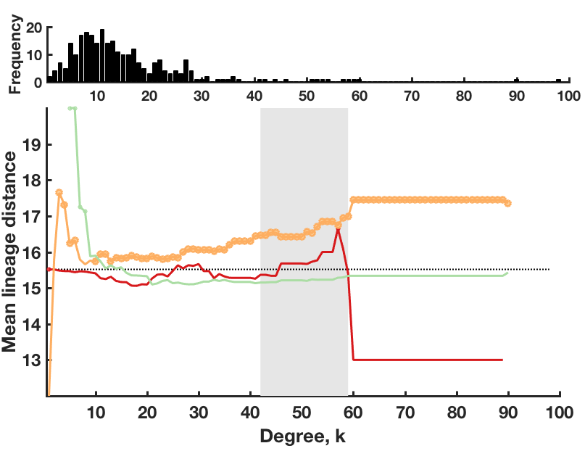
Rich
Feeder
Peripheral

Slide 14
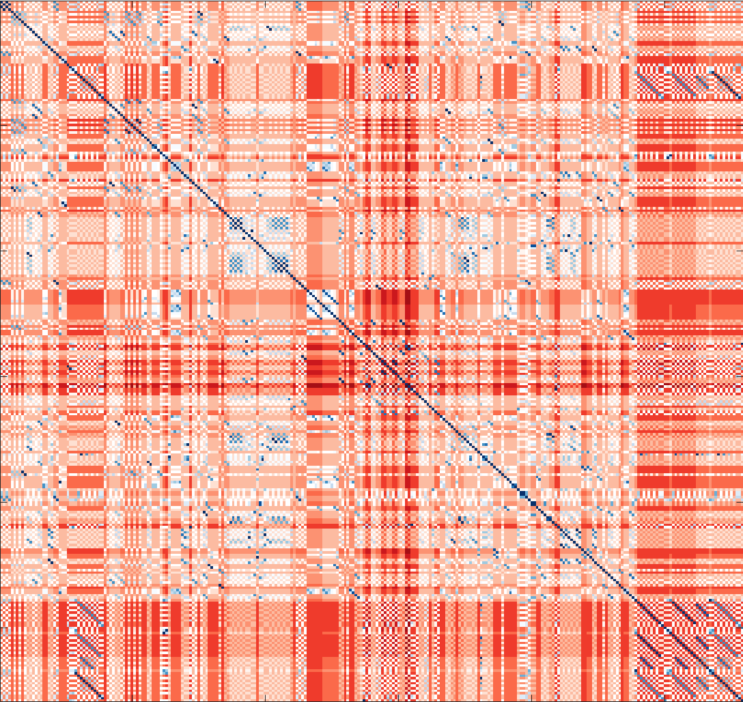

Slide 15
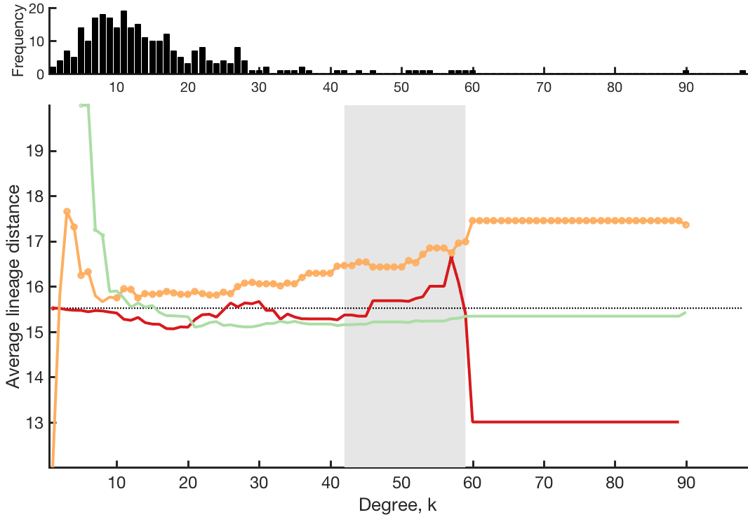

Slide 16
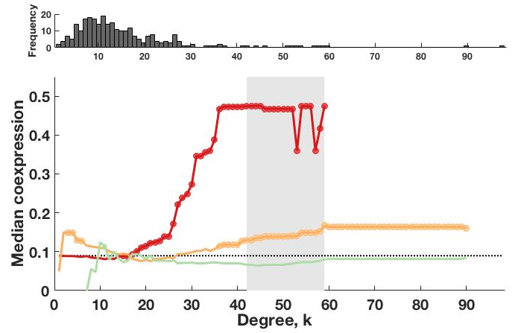
Rich
Feeder
Peripheral

Slide 17
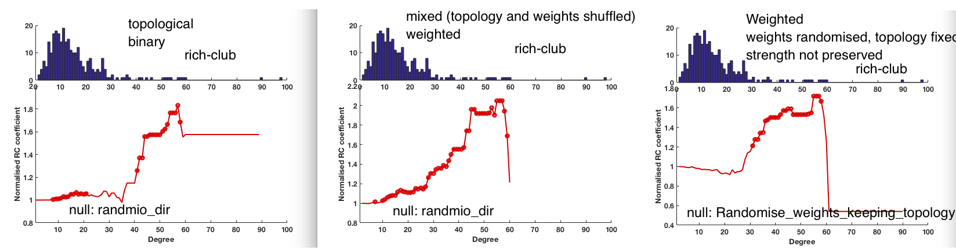

Slide 19
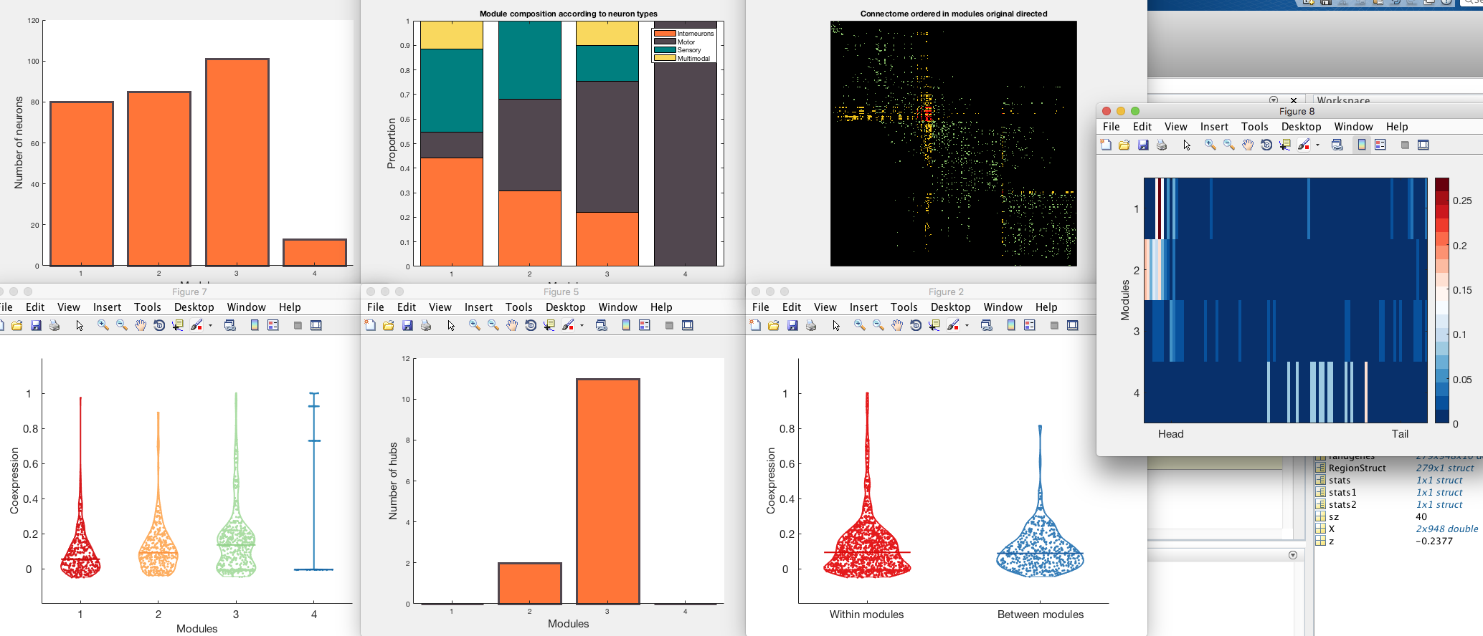


Slide 20
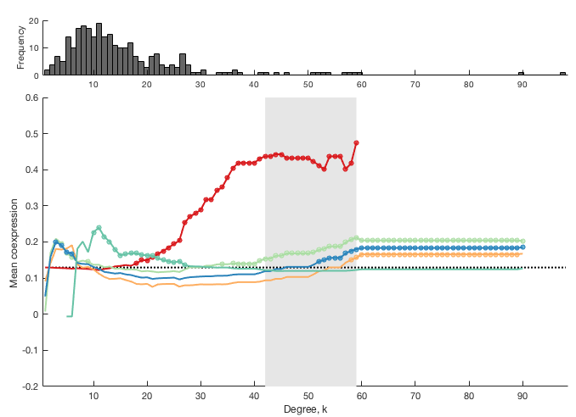

Slide 21
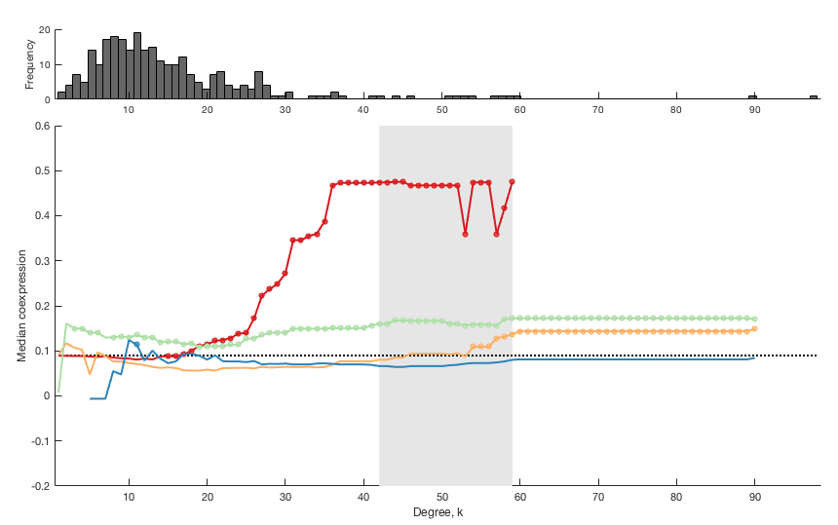

Slide 22
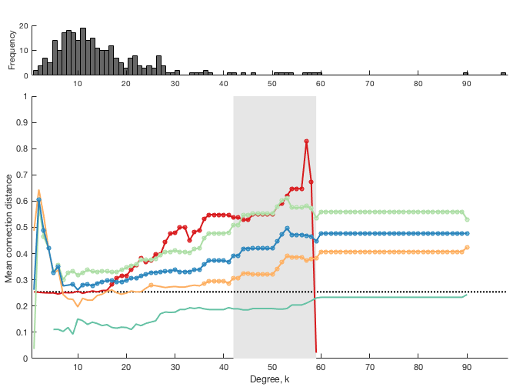

Slide 23
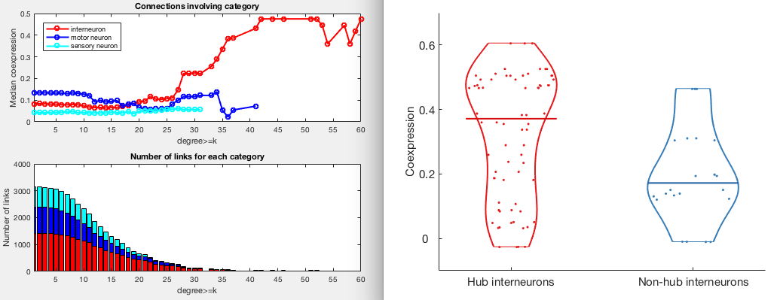

Slide 24
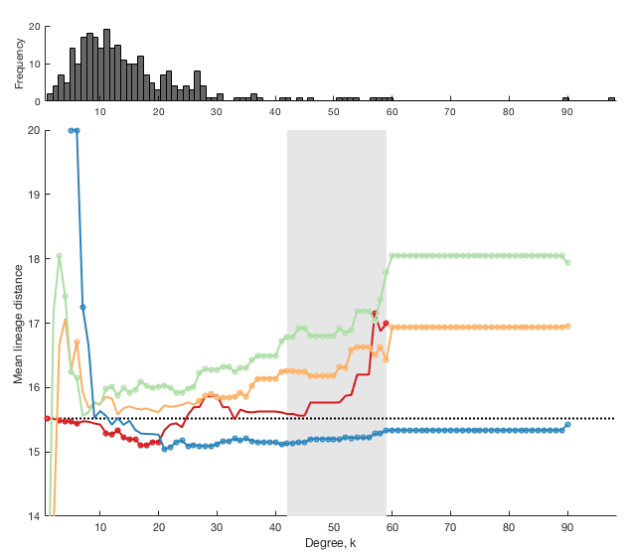

Slide 25
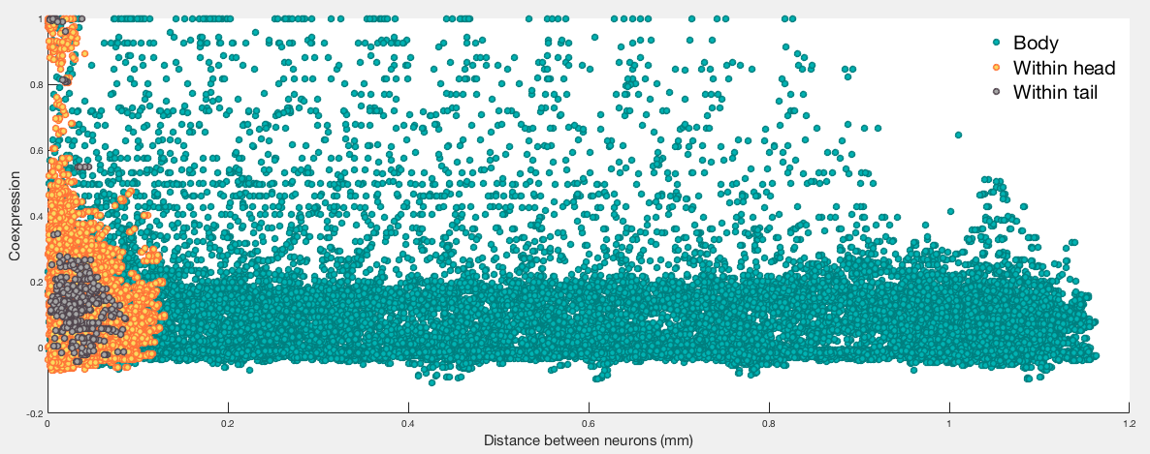

Slide 26
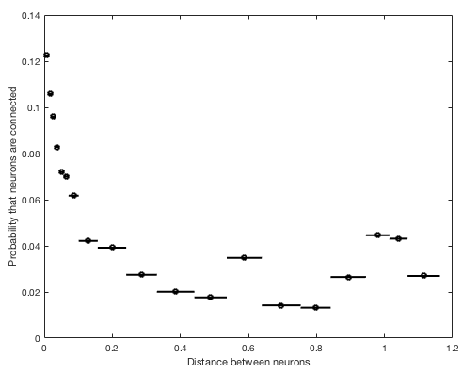

Slide 27
A
B
C
D

Slide 28
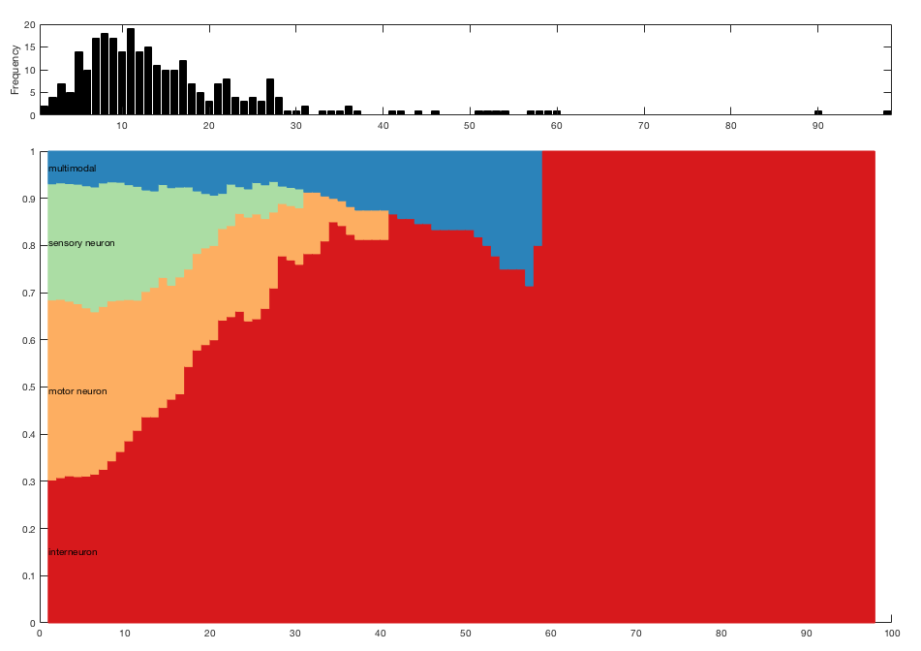
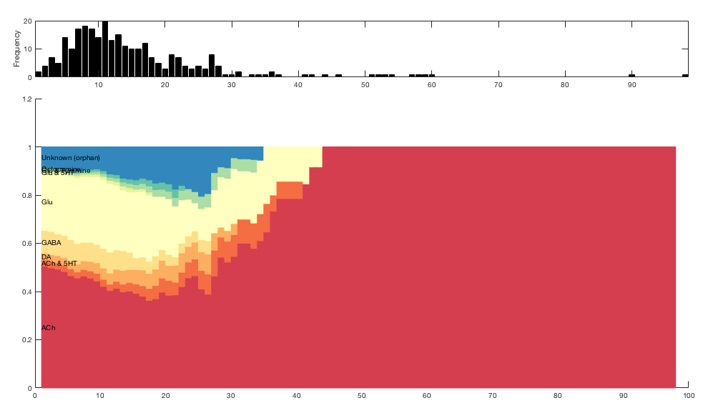

Slide 30
